Slide 1
Crop Yield Prediction using Environmental Data
By Sivanagavalli

Slide 2
Objective : Predict Crop yield(tons per ha)
Algorithm : RandomForestRegressor
Domain : Agriculture/Machine Learning
Tools: Python,pandas,Matplotlib,Scikit-learn

Slide 3
Problem Statement
Predict
Predict Agricultural crop yield using environmental and soil factors
Improve
Improve decision making for farmers
Reduce
Reduce uncertainty in crop production

Slide 4
Project Flow
1.Data Collection
2.data Preprocessing
3.Train-Test-Split
4.Model training(RandpmForestRegressor)
5.Evaluation(Metrics R2 score,MAE,MSE)
6.Prediction

Slide 5
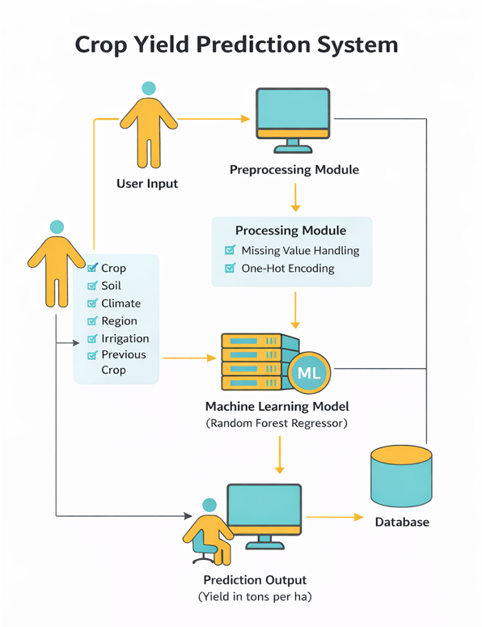

Slide 6
Data Collection: From Kaggle
Load and read CSV file
Data Preprocessing: Remove Irrelevant columns
Checking and Handling null values
Encoding categorical data to numerical(OnehotEncoding )
No Scaling done as randomForestRegressor model
FeatureEngineering
Data Split: 80% training , 20% for testing
AlgorithmUsedForModelFit:RandomForestRegressor
Fit the model with training data
Predict with testing data
Metrics: r2_score,mean_absolute_error
Deploy the model with new data

Slide 7
Conclusion
And
Future Work
Conclusion:
The developed machine learning system successfully predicts crop yield using environmental, soil, and agricultural features
Future Work
Incorporate weather forecast APIs for dynamic predictions
Deploy as a web or mobile application

